Slide 1
Insuchef
Meal Magicians / S2G7

Slide 2
What is Insuchef?
InsuChef is an application that designed to help diabetic people and facilitate their lives with its additional features.

Slide 3
Required Features
Profile
Favorites
The profile page includes user information and preferences that can be adjusted.
Users are able to choose their favorite meals and access them more conveniently.
Food addition
Carb restrictions
Users are able to add their own meals to the food list and access them.
Users can put restrictions on their meals and calculate carbohydrate consumption accordingly.

Slide 4
Required Features
Nutrition information
searching
Users can easily find the food by using the search bar instead of scroll bar.
Users can see additional nutrition information in the meal selection.
User-friendly interface
categorization
Foods can be listed according to their nutritional values.
The user interface is kept understandable for everyone to use it conveniently.

Slide 5


Technologies
Android studıo
JSON
Android application development tool
For retrieving data from the database

Slide 6


Technologies
Internal and external libraries
For storing local data and facilitating users’ experiences

Slide 7
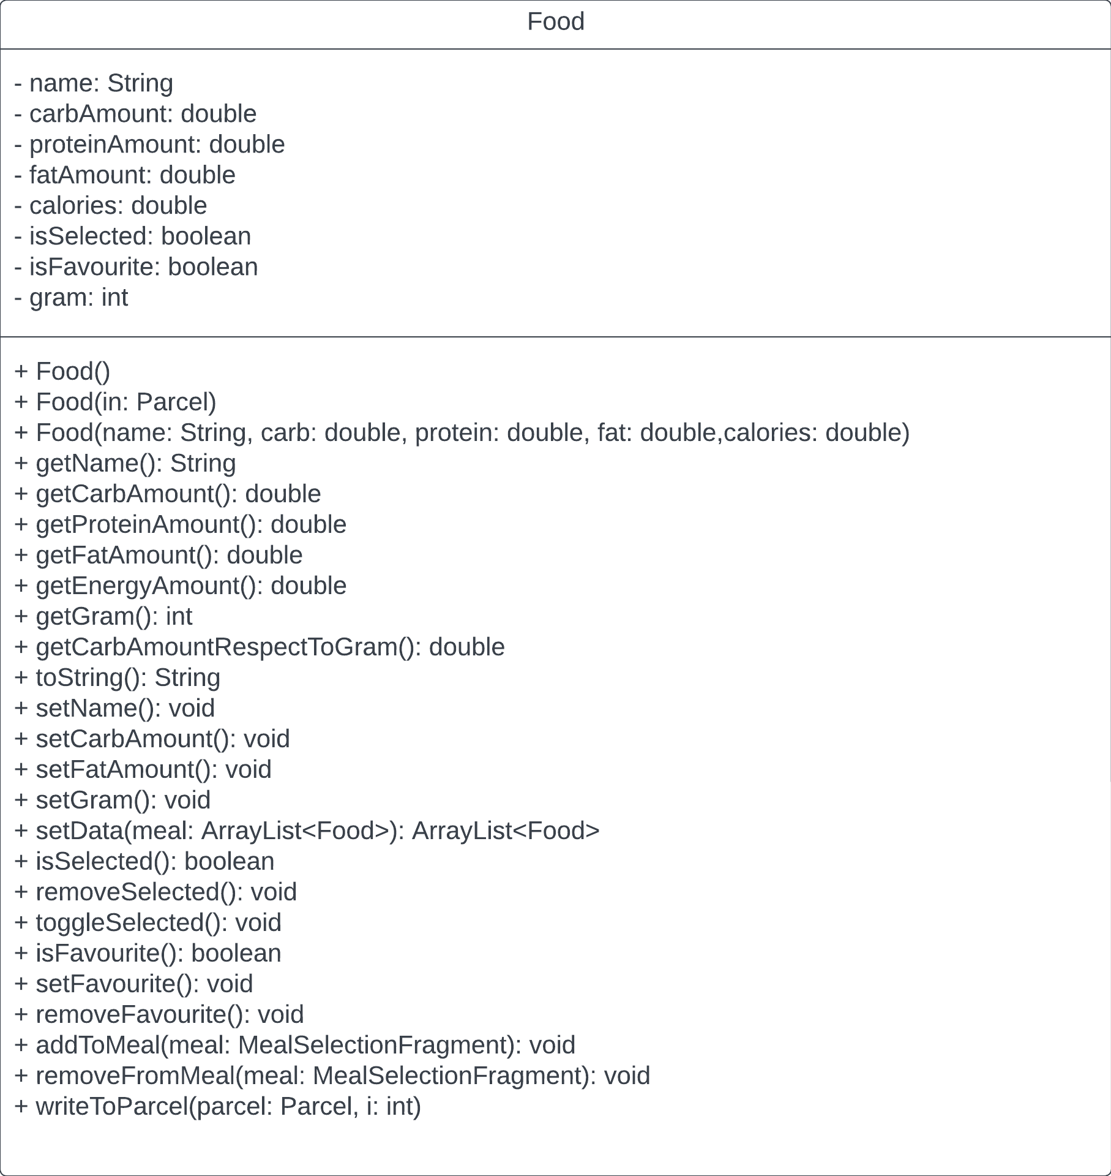
Class Diagrams

Slide 8
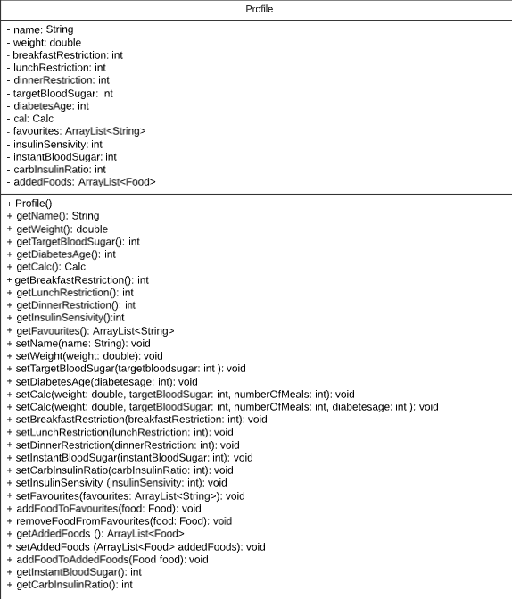
Class Diagrams

Slide 9
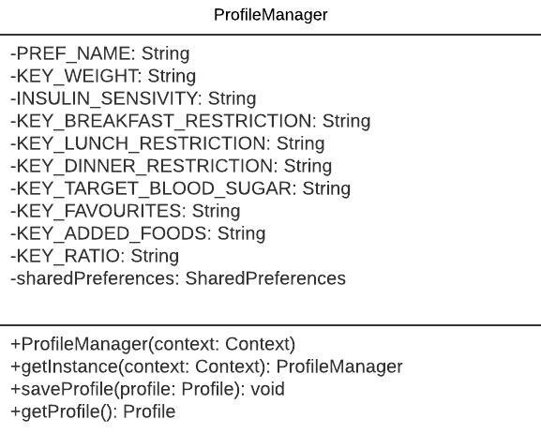
Class Diagrams

Slide 10
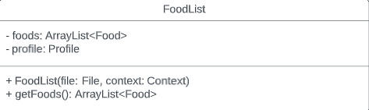
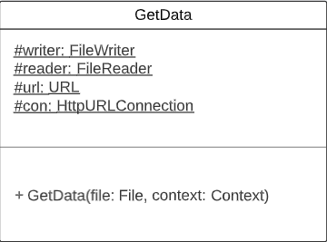
Class Diagrams

Slide 11
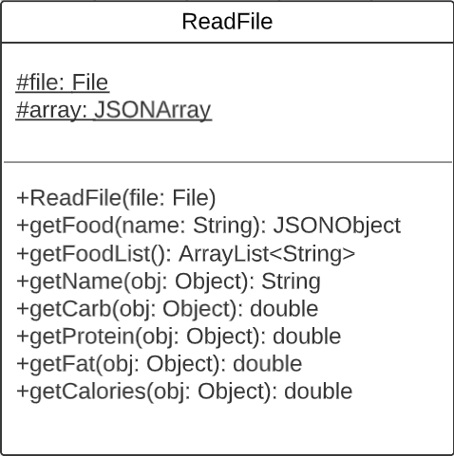
Class Diagrams

Slide 12
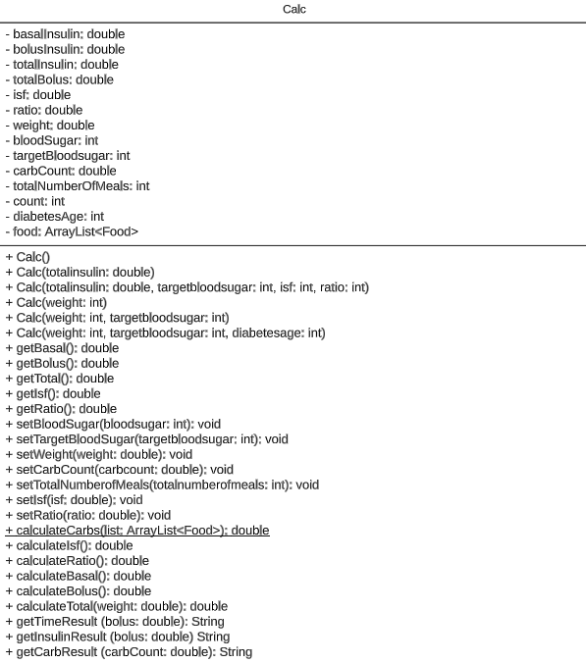
Class Diagrams

Slide 13
Accomplished goals
Learning Android Studio
Learning to design XML files
Learning the use of JSON to get data
Learning to store local data via libraries

Slide 14
Emine Fidan
Umay Dündar
Edip Emre Dönger
Elif Ercan
Yiğit Kemal Can

